Slide 1
Maths
Unit 2 – Numbers and Sequences
27.08.2026
WALT: Count on and count back in numbers of constant size, including fractions and decimals, and extend beyond zero to give negative numbers.

Slide 2



WALT: Count on and count back in numbers of constant size, including fractions and decimals, and extend beyond zero to give negative numbers.
I can count on and back in numbers of constant size.
I can fill in the missing numbers of sequences.
I can write my own sequences using fractions and decimals and they extend beyond zero.

Slide 3
Retrieval Practice – Which of these numbers is the odd one out? Why?
WALT: Count on and count back in numbers of constant size, including fractions and decimals, and extend beyond zero to give negative numbers.
16.49
17.34
16.51

Slide 4
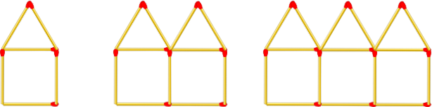
Starter – What do you notice about this pattern?
WALT: Count on and count back in numbers of constant size, including fractions and decimals, and extend beyond zero to give negative numbers.

Slide 5
How could we continue the sequence?
WALT: Count on and count back in numbers of constant size, including fractions and decimals, and extend beyond zero to give negative numbers.
Use sticks to continue the sequence.
Count how many sticks we add each time and think of a term to term rule.

Slide 6
We will look at term to term and position to term rules more next lesson.
WALT: Count on and count back in numbers of constant size, including fractions and decimals, and extend beyond zero to give negative numbers.
Today we are going to concentrate of counting on and counting back.

Slide 7


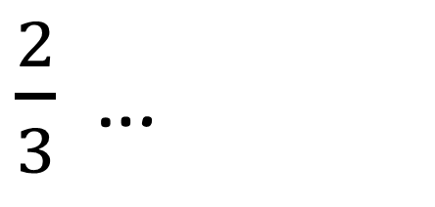

You need to be able to count on and back in fractions…
WALT: Count on and count back in numbers of constant size, including fractions and decimals, and extend beyond zero to give negative numbers.
$$\frac{1}{6}$$
$$\frac{1}{3}$$
$$\frac{1}{2}$$
$\frac{2}{3}$ …
What are the next terms in this sequence?

Slide 8
You need to be able to count on and back in decimals…
WALT: Count on and count back in numbers of constant size, including fractions and decimals, and extend beyond zero to give negative numbers.
0.65, 0.61, 0.57, 0.53 …
What are the next terms in this sequence?

Slide 9
You need to be able to count on and back past zero to give negative numbers…
WALT: Count on and count back in numbers of constant size, including fractions and decimals, and extend beyond zero to give negative numbers.
12, 8.5, 5, 1.5 …
What are the next terms in this sequence?

Slide 10
What happens if we are given the first and last term of the sequence? How can we find the missing numbers?
WALT: Count on and count back in numbers of constant size, including fractions and decimals, and extend beyond zero to give negative numbers.
4, ____, ____, ____, ____, _____34

Slide 11
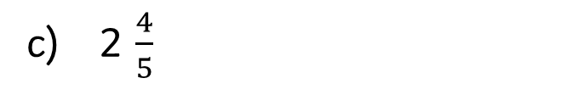
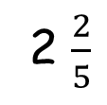
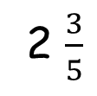
WALT: Count on and count back in numbers of constant size, including fractions and decimals, and extend beyond zero to give negative numbers.
Write the next 3 terms in each of these sequences.
All the sequences below are linear. Write the missing numbers:
2, … , …, …, 14
5, … , … , … , 25
14, … , … , … , 6
18, … , … , … , - 10
a) ½ , 1 , 1 ½
Write your own sequences using decimals or fractions.
b) 0.45, 0.6, 0.75
2 $\frac{3}{5}$
2 $\frac{2}{5}$
c) 2 $\frac{4}{5}$
d) 0.34, 0.23, 0.11

Slide 12
WALT: Count on and count back in numbers of constant size, including fractions and decimals, and extend beyond zero to give negative numbers.
I can count on and back in numbers of constant size.
I can fill in the missing numbers of sequences.
I can write my own sequences using fractions and decimals and they extend beyond zero.

Slide 13
Plenary
WALT: Count on and count back in numbers of constant size, including fractions and decimals, and extend beyond zero to give negative numbers.
Mr. Jon has created a linear sequence.
7, ____, ____, _____, - 8
He says:
“To find the missing numbers, I need to find the difference between 7 and -8, then divide by the number of jumps. The term to term rule is -3. ”
Is he correct?

